Slide 1
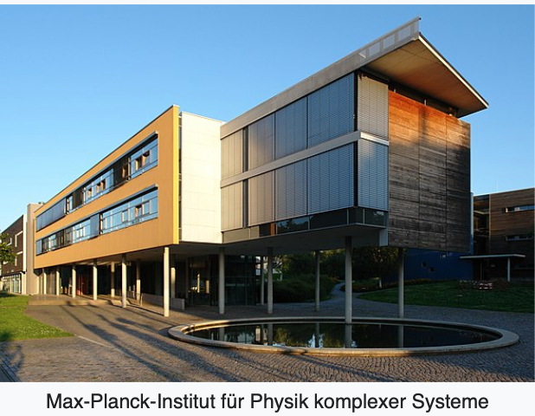

Wavepacket dynamics at conical intersection and its spectroscopic manifestation
Lipeng Chen
Max Planck Institute for the Physics of Complex Systems, Germany
Dec 9, 2021, VISTA Seminar

Slide 2
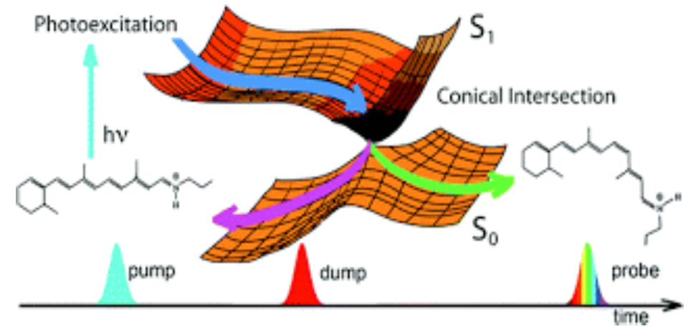
Conical intersections

Slide 3
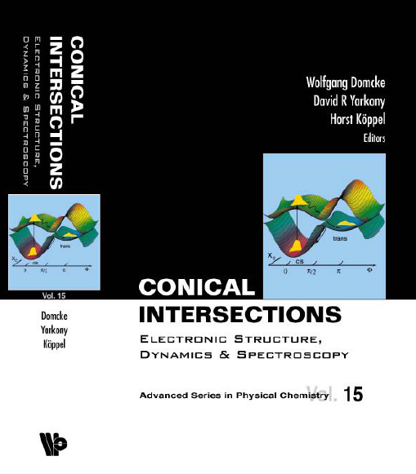

Dynamics at conical intersections in dissipative environment
Spectroscopic characterization of conical intersections: Recent suggestions

Slide 4
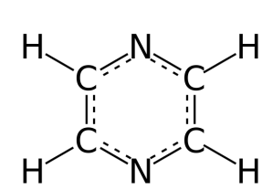
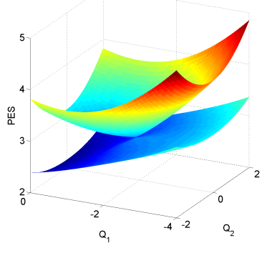
24-mode conical intersection model of pyrazine
Multimode quantum dynamics with a multiple Davydov D2 trial states: Application to a 24-dimensional conical intersection model

Slide 5
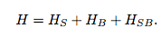
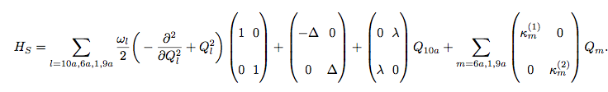
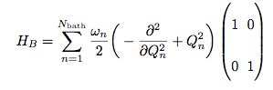
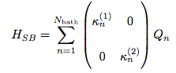
Model Hamiltonian

Slide 6
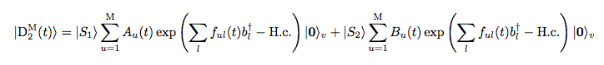
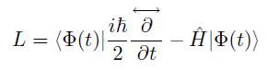
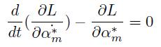
Multiple Davydov ansatz
Multiple Davydov D2 ansatz
state amplitude
phonon displacement
Dirac-Frenkel time-dependent variational method

Slide 7
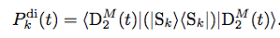
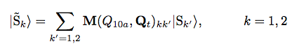
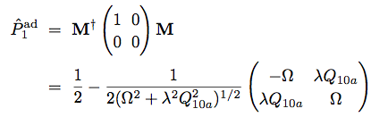
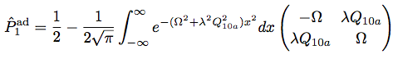
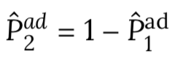
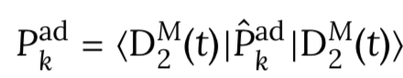
Observables
diabatic state population
adiabatic state population

Slide 8
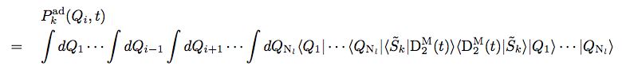
Observables
adiabatic wave packets

Slide 9
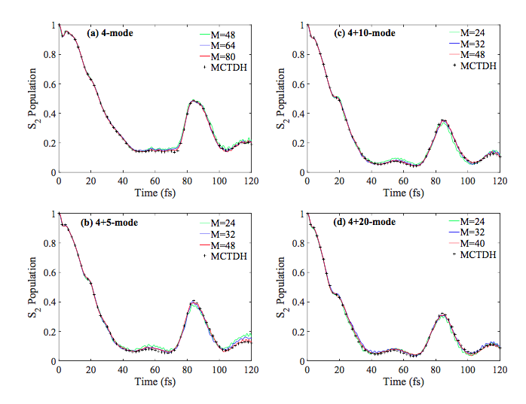
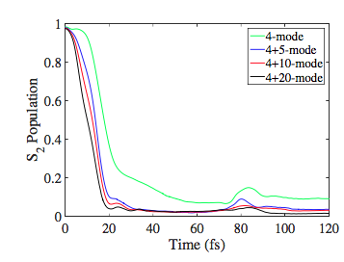
Diabatic and adiabatic population
Diabatic population
Adiabatic population
J. Chem. Phys, 150, 024101, 2019

Slide 10
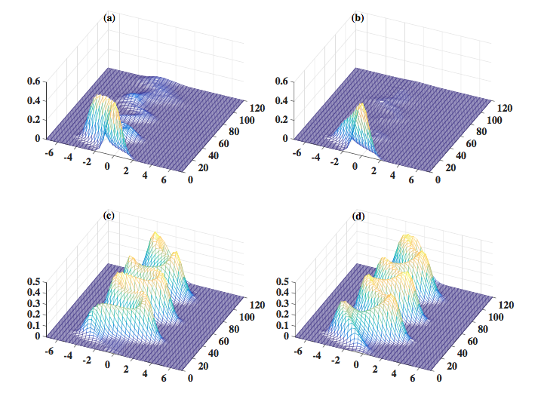
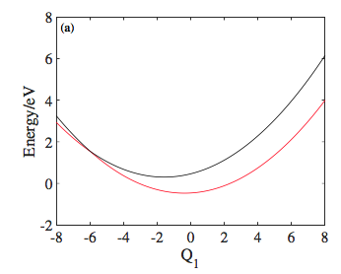
Wavepacket dynamics
J. Chem. Phys, 150, 024101, 2019
4mode
4+20 mode

Slide 11
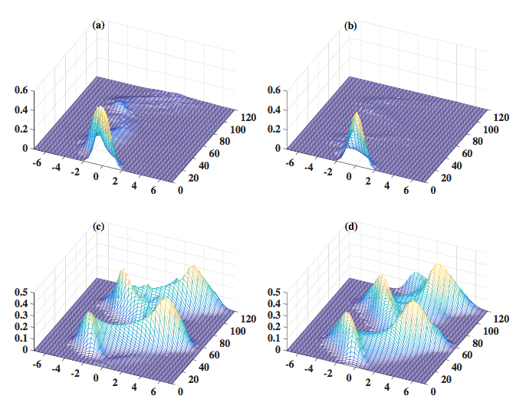
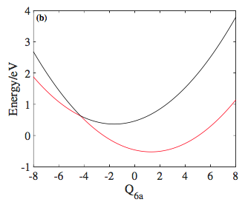
Wavepacket dynamics
J. Chem. Phys, 150, 024101, 2019
4mode
4+20 mode

Slide 12
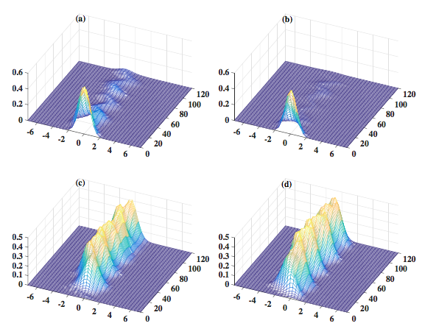
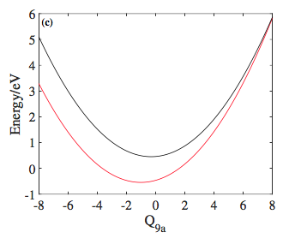
Wavepacket dynamics
J. Chem. Phys, 150, 024101, 2019
4mode
4+20 mode

Slide 13
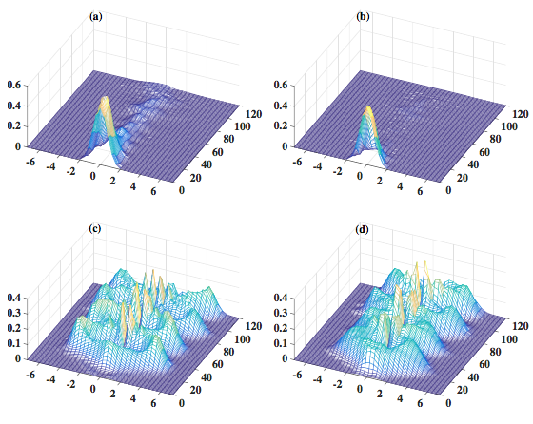
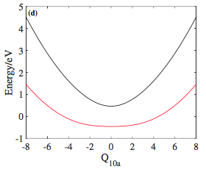
Wavepacket dynamics
J. Chem. Phys, 150, 024101, 2019
4mode
4+20 mode

Slide 14
How to detect & characterize dynamics at conical intersections via
Multidimensional spectroscopy

Slide 15
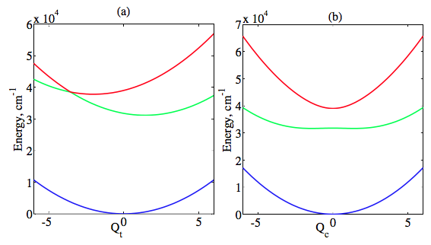
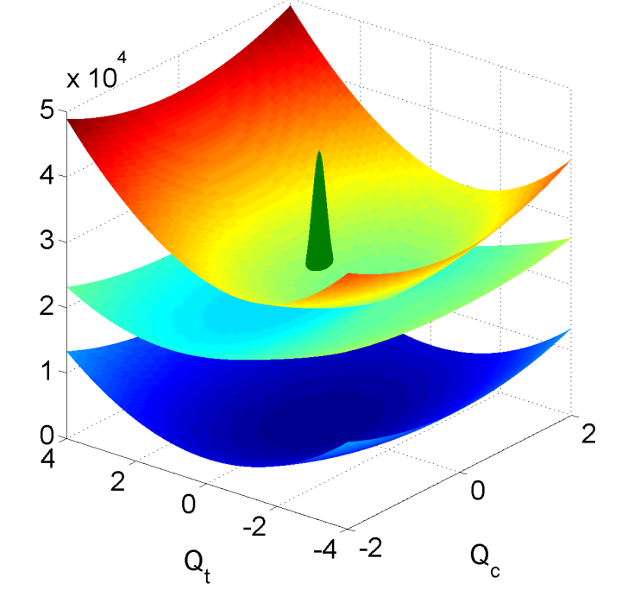
Time &frequency resolved fluorescence
Take a minimal two-electronic-states two-vibrational-modes model of conical intersection (S₁(nπ*)-S₂(π*π*) conical intersection in pyrazine)
Couple the conical intersection to the dissipative environment
2(time delay)
3(emission)
1(excitation)

Slide 16
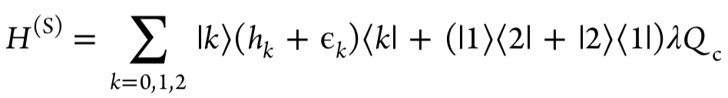
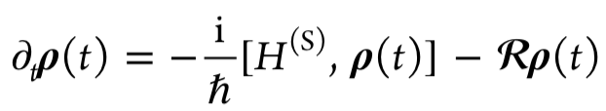
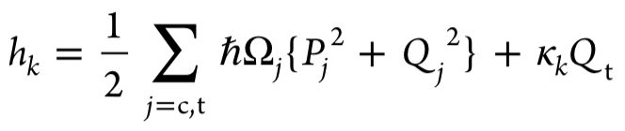
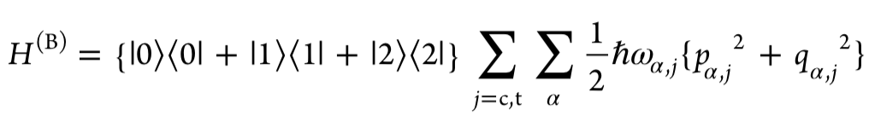
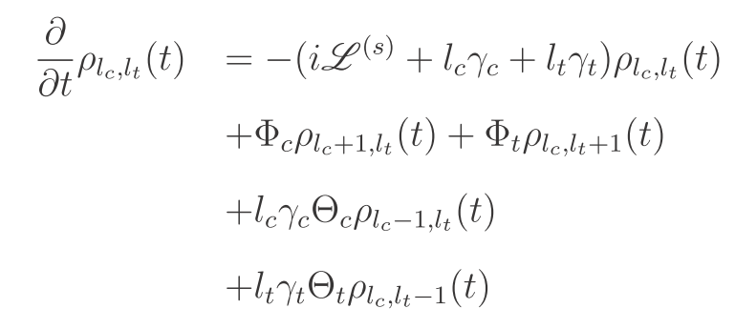
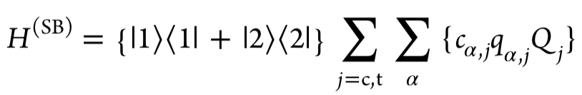
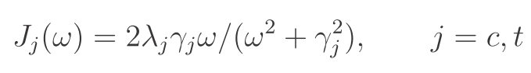
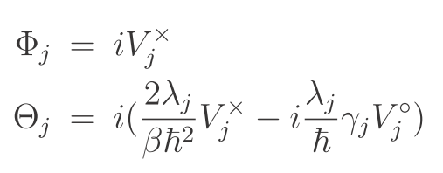

Hierarchy Equation of Motion (HEOM)
HEOM (Tanimura, Kubo)
A Tensor Library for GPUs

Slide 17
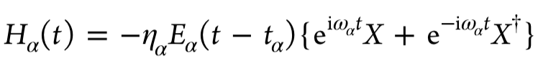
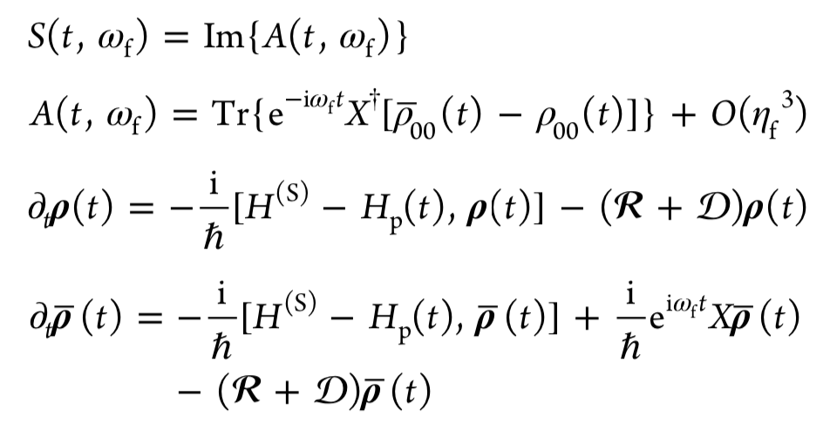
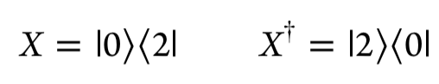
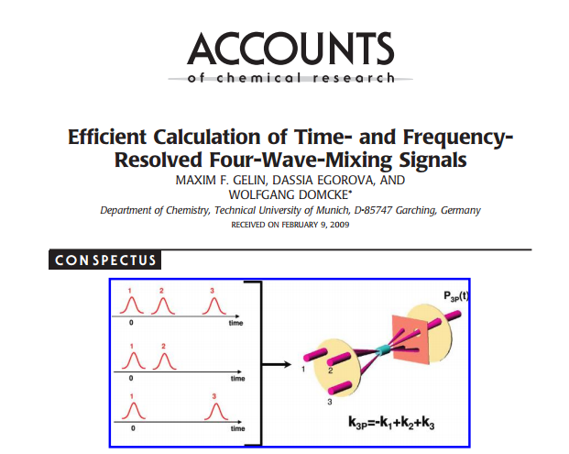
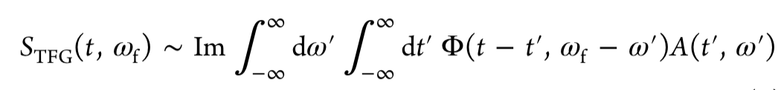
Equation of Motion Phase matching approach (EOM-PMA)
System-field interaction Hamiltonian
Ideal spontaneous emission spectrum
Equation of motion phase-matching approach (EOM-PMA)
[Maxim Gelin and Wolfgang Domcke]
gate pulse
fluorescence
pump pulse
Measurable time- and frequency-gated (TFG) SE spectrum

Slide 18
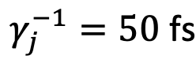
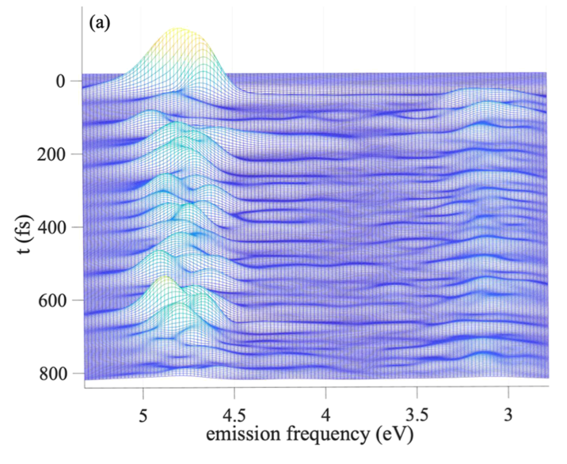
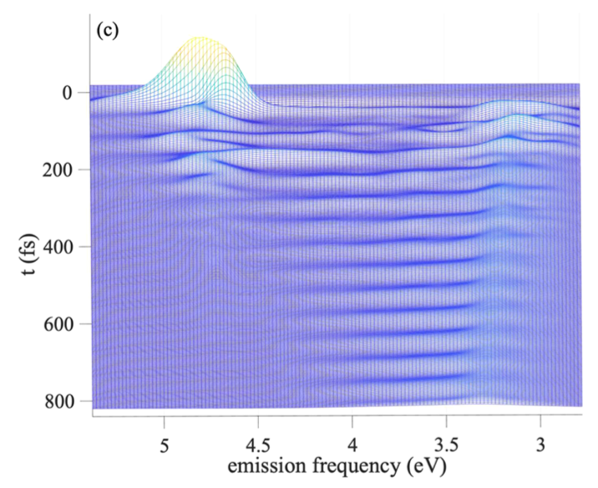
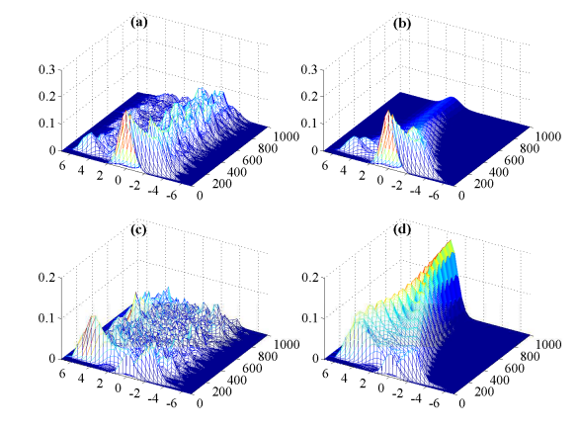
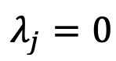
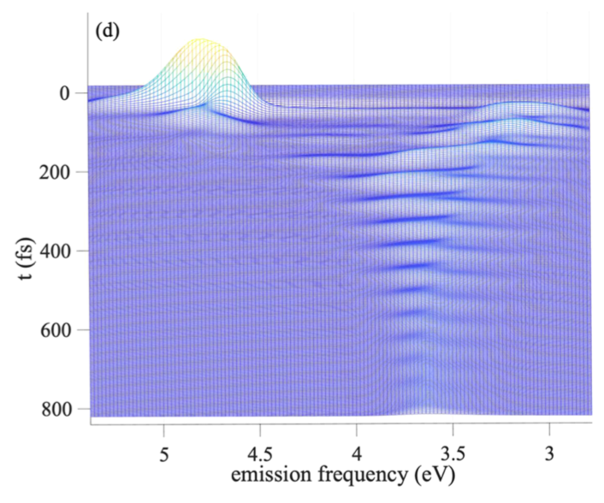


Time- and Frequency-Resolved Fluorescence Spectra
time delay
emission
excitation
Zero system-bath coupling
Weak system-bath coupling
intermediate system-bath coupling
J. Phys. Chem. Lett, 10, 5873-5880, 2019

Slide 19



Electronic 2D spectroscopy

Slide 20


Double-Sided Feynman Diagrams
Stimulated Emission
Ground state bleaching
coherence
time
Population
time
Coherence
time

Slide 21
Double-Sided Feynman Diagrams
Excited state absorption
coherence
time
Population
time
Coherence
time

Slide 22




Simulation of four-wave-mixing signals with multiconfigurational Ehrenfest dynamics
Hamiltonian
System-field interaction Hamiltonian

Slide 23


Four time correlation functions
Multiconfigurational Enrenfest
Dynamics (MCE, Dmitry Shalashilin)

Slide 24


Simulation of 4WM signals with MCE
Stimulated emisssion (SE)
ground state bleach (GSB)
2D spectra
Transient absorption (TA) spectroscopy
Time-resolved fluorescence spectroscopy

Slide 25




TFG fluorescence spectra
good time resolution
good frequency resolution
J. Chem. Phys, 154, 054105, 2021

Slide 26


Transient absorption signal
J. Chem. Phys, 154, 054105, 2021

Slide 27


2D electronic spectra
J. Chem. Phys, 154, 054105, 2021

Slide 28








Efficient simulation of time and frequency resolved four wave
mixing signals at finite temperature: The thermo-field dynamics approach
Zero temperature four-time correlation function
Finite temperature four-time correlation function
Thermo-field dynamics (TFD)

Slide 29


Efficient simulation of time and frequency resolved four wave
mixing signals at finite temperature: The thermo-field dynamics approach
Thermo-field dynamics (TFD)
Zero temperature four time correlation function

Slide 30







Model Hamiltonian of CI mediated singlet fission in rubrene
Two states singlet fission model
Singlet state S_1
Triplet pair state TT

Slide 31



TFG fluorescence spectra
Upper panels: good time resolution
Lower panels: good frequency resolution
J. Chem. Theory. Comput, 17, 4359-4373 (2021)

Slide 32

Transient absorption spectra
J. Chem. Theory. Comput, 17, 4359-4373 (2021)

Slide 33

2D electronic spectra at T=0K
J. Chem. Theory. Comput, 17, 4359-4373 (2021)

Slide 34

2D electronic spectra at T=100K
J. Chem. Theory. Comput, 17, 4359-4373 (2021)

Slide 35

2D electronic spectra at T=200K
J. Chem. Theory. Comput, 17, 4359-4373 (2021)

Slide 36

2D electronic spectra at T=300K
J. Chem. Theory. Comput, 17, 4359-4373 (2021)

Slide 37

2D electronic spectra at T=0K,100K,200K,300K
J. Chem. Theory. Comput, 17, 4359-4373 (2021)

Slide 38

On the fly Ab initio surface hopping simulations of four-wave-mixing signals of
Nonadiabatic Excited-State Dynamics Using the Doorway-Window representation
On-the-fly Ab initio direct dynamics:
Only local information of adiabatic PES needed, computed “on-the-fly” with ab initio electronic structure theory,
avoid the tedious construction of global PES.
2. Cost of classical trajectory scales linearly with DOFs, avoids the curse of dimensionality
Nonadiabatic transition between adiabatic PES→ surface hopping
Doorway-window representation of the signals
Create doorway wave packet
via pump pulse
Window wavepacket created by
Probe pulse
Time evolution of doorway wave packet is projected into the window wave packet.

Slide 39






Hamiltonian
Electronic ground state

Slide 40



Nonlinear response functions
Pump-probe signals
Time delay between the pump and probe pulses
envelope of the probe pulse
J. Chem. Theory. Comput, 17, 2394-2408 (2021)

Slide 41






Doorway-window representation of the pump-probe specra
GSB
density loss in the
ground state
SE
ESA
light-induced
density in the manifold I
For changing to classical trajectories
1. Classical Condon approximation
2. Classical Averaging
3. Classical population evolution
T-evolutions of
GSB
SE
ESA
evolutions over trajectories in the electronic ground state and lower-lying excited electronic states
J. Chem. Theory. Comput, 17, 2394-2408 (2021)

Slide 42


Transient absorption pump probe spectra for pyrazine
eV
low-lying excited states
The next 30 electronic states
with vertical excitation energies up
to 10eV
High-lying excited states
J. Chem. Theory. Comput, 17, 2394-2408 (2021)

Slide 43
Outlook
Tw=0fs
Tw=600fs
Use cavity to control the photochemistry and characterize its dynamics by multidimensional spectroscopy
Simulate time-resolved X-ray (electron) diffraction of CI systems (the structural change associated with the electronic transitions)

Slide 44






Acknowledgements
Tw=0fs
Tw=600fs
Prof. Maxim Gelin (HDU)
Prof. Wolfgang Domcke, TUM
Prof. Zhao Yang, NTU
Prof. Vladimir Chernyak, WSU
Prof. Dmitry Shalashilin, U of Leeds
Prof. Raffaele Borrelli, U of Torino
Financial support
MPI-PKS visitors program
… questions?
… questions?
… questions?

